Slide 1
Welcome to the world of 8051 – Interfacing Exercises
Shriram K Vasudevan
YouTube Channel: https://www.youtube.com/user/master4hereever
(You can search as Shriram Vasudevan as well)

Slide 2
Agenda
8051 interfacing with
Stepper Motor
LCD (Self Study – Will be given material on request)
DC Motor

Slide 3
Stepper Motor
Have been using it for a long time inside the printers, floppy disk drives, CD Drives and some robotic projects that have been done.
It is again a motor only with a small difference. As all motors do it converts electrical power to mechanical power.
The difference between the normal motor and stepper motor is with the way they rotate.
Normal motors will rotate continuously whereas in stepper motor, rotations happen in fixed steps. Each step will be a part of the complete circle. Means many steps will form one complete circle

Slide 4
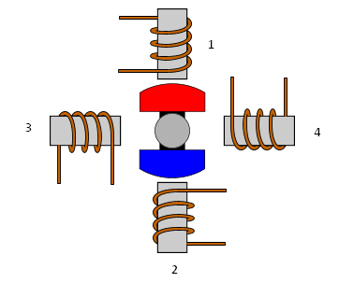
Contd.,
Any motor will have a stator and a rotor.
A rotor will have permanent magnets and stator has coils. It will look something like what is shown.
As shown in the figure there are 4 coils with having angle of 90 deg between each other fixed on the stator.

Slide 5
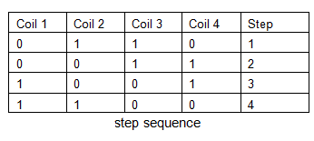
Contd.,
The coils will be activated one after another and they will be activated in order and it decides the rotation direction. i.e. it can be clockwise or anticlockwise.
This kind of stepper motors are normally referred to be as 4 phase stepper motor or uni-polar stepper motor.
Based on the sequence of power applied to the stator windings, the rotor will start rotating.
There are many sequences followed and one of them is 4 step sequences.
One can find the hexadecimal equivalent of the sequence in the table and can load it to get the stepper motor running.

Slide 6
Contd.,
The equivalent Hex values for the above sequence is 06H, 03H, 09H and 0CH.
The next section is to try interfacing the 8051 with stepper motor.
After that, the code can be written to make the stepper motor rotate the way the programmer wishes to, clockwise or anti clockwise.
To make the stepper rotate, sending a pulse to each coil is required and becomes mandatory.

Slide 7
Contd.,
8051 is not strong enough and does not have sufficient driving ability on its output to drive each coil, and a way should be found to drive the stepper motor.
There is a way, thanks to transistors. Transistors can be used.
But better way is to use the drivers which are available in the market.
ULN 2003 is the driver IC which is normally used for this purpose.

Slide 8
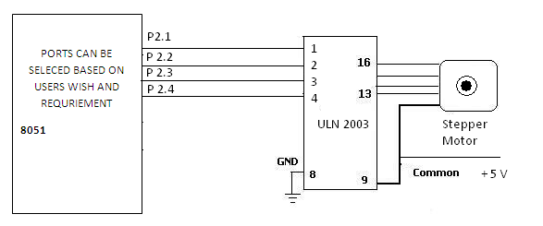
Contd.,

Slide 9
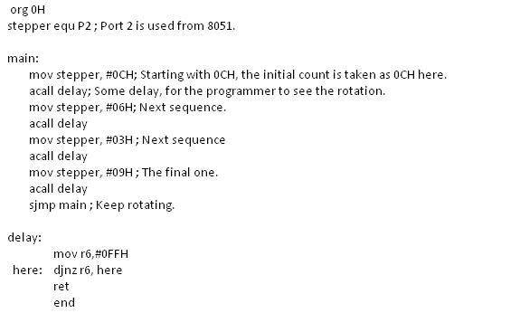
Let us code!

Slide 10
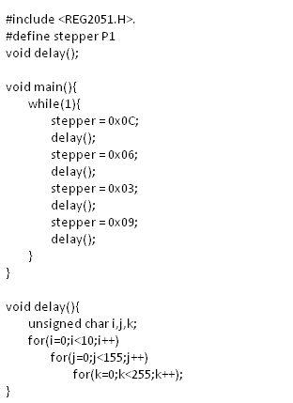
Can we ‘C’ it?

Slide 11
Important Terms…
Step angle
It is defined as an angle through which motor shaft rotates in one single step. Step angle can be different for different motors. How to choose the stepper motor then? How is the step angle playing a role? Simple, if the application needs small increments in the rotation one should choose motor having smaller step angle.
No of steps require to rotate one complete rotation = 360 deg. / step angle in degrees.
If somebody wants 200 steps per revolution, then the following equation would
200 Steps per revolution = 360 / Step angle.
Steps/second
The relation between RPM and steps per second is calculated with
Steps/sec. = (RPM X Steps per revolution) /60

Slide 12
DC Motor Interfacing.
DC motor is a most commonly used machine in the electrical world.
It as every other motor does converts the electrical pulses to mechanical movement.
DC Motor will have 2 polarities, one is +ve and the next is –ve and this is very common with all DC appliances.
Motor can be made to rotate by just connecting them to appropriate polarities.
By reversing the polarity one can make it rotate in the reverse the direction of rotation of the DC motor easily.

Slide 13
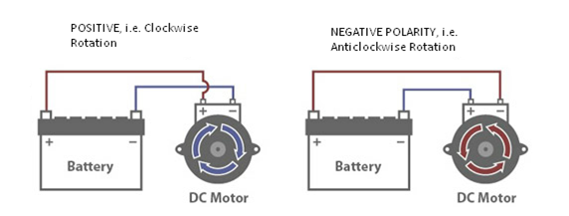
Contd.,
DC motor finds widespread applications in the areas of cooling fans inside the electronic equipment which are found to be very vital and useful.
Computer motherboards are in need of cooling agent and the DC motor will help in cooling of the processor.
The speed that the DC motor rotates is mentioned with the unit RPM (Rotation per minute). If RPM of a motor is specified as 1000 RPM then it makes 1000 rotations per minute.

Slide 14
Contd.,
How can one interface the DC Motor with the microcontroller?
What are the obligatory things to be done for this interfacing to be achieved?
Here are the steps and descriptions.

Slide 15
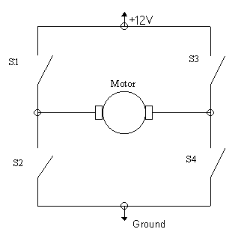
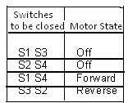
Contd.,
H-Bridge is the most commonly used way for connecting or interfacing a DC motor with a microcontroller.
How can one build this structure? With having some switches the H Bridge can be constructed easily and direction of rotation of motor can be controlled with that switches.
One can see that 4 switches are deployed and with that switches one can play around.

Slide 16
Contd.,
When all the switches are open, it will not allow the motor to run at all.

Slide 17
Contd.,
Well, making the H- Bridge setup might be tougher.
So for making the task easier, one can use the driver IC L293D.
It is a very popular and frequently used H-Bridge driver IC and with which one can interface 2 DC motors.
And to note, both of the DC motor’s direction of rotation can be controlled with ease.

Slide 18
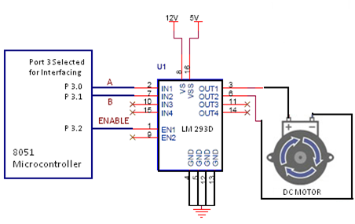
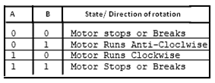
Contd.,
Just 3 pins are sufficient for the interfacing to be done.
A, B and Enable are connected to the 8051’s port 3 with having P3.0 connected to A, P3.1 connected to B and P3.2 to enable.

Slide 19
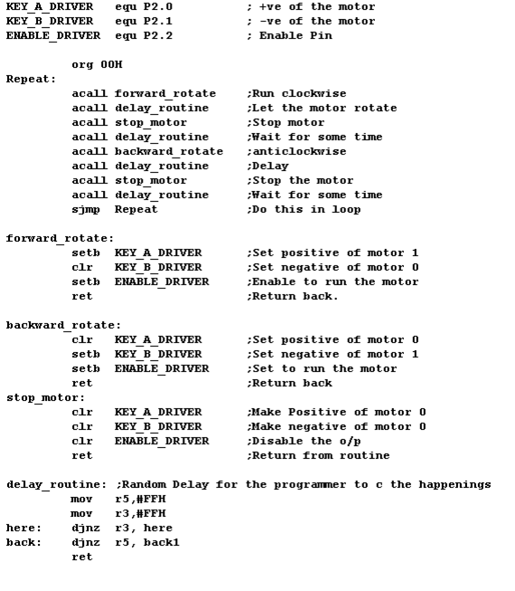
Contd.,

Slide 20
Thanks a lot for watching!
All the best!
Shriram k vasudevan

